Slide 1
CG1112
Week 5 – Studio 1
GPIO Programming

Slide 2
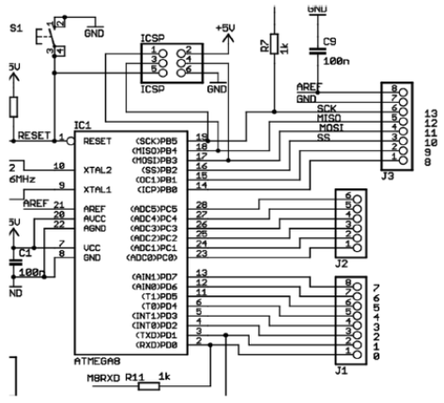
Bare Metal:
Efficient
Fundamental
Port Configuration( 1 = Output, 0 = Input)
 | 7 | 6 | 5 | 4 | 3 | 2 | 1 | 0
DDRx
Port Output
 | 7 | 6 | 5 | 4 | 3 | 2 | 1 | 0
PORTx
Port Input
 | 7 | 6 | 5 | 4 | 3 | 2 | 1 | 0
PINx
DDRB = 0b00001000; //DDRB = 8
DDRB |= 0b00001000;
//Masking Examples
Result = PINB & 0b00000001;
PORTB = PORTB | 0b00010000;
Arduino Pin ←→ Atmega Port

